Slide 1
Disaster Relief Project Detecting Blue Tarps Part 2
NAME Matthew Thomas
DATE 11/24/19
COURSE NAME AND NUMBER SYS6018

Slide 2
METHODS RESULTS CONCLUSIONS
In this section you should explain the methods you used:
I used R along with packages caret, ranger, MASS, kernlab, and glmnet
For each classification method, I did 10 fold CV on the training set twice: once with the original categories, and once with two categories: Yes or No for whether it was a blue tarp or not. The idea was to compare the results from two vs multi category classification.
I created the same folds on the training data to use for cross-validation in advance so that each model was using the exact same folds in each 10xCV. This makes comparing the results more reliable.
For each model, I used Sensitivity (detection rate) as the metric for selecting the best model rather than accuracy.
For logistic regression, there was no pre-processing (other than making the two categories). I used the glmnet package in caret and the two class and multi-class came out very similarly. I ended up using the two-class on the test data and got very good results. My preferred confusion matrix (shown at the end) used a cut-off probability threshold of 0.6, which did a good job minimizing the False Alarm Rate.

Slide 3
METHODS RESULTS CONCLUSIONS
For knn I used the MASS package and settled on the multi-class set. The training results were very good but fit the hold-out data poorly. To the right is a graph showing the CV results in picking our value for k
I used Sensitivity (Detection Rate) as my metric for picking the best model (using accuracy resulted in higher levels for K but those models were worse). As you can see, lower values for k gave better Detection Rates.
Knn models did a bad job fitting the hold-out data. This makes sense because depending on the metric used, R would recommend very different models.
Centering and scaling the data resulted in a slightly better model.

Slide 4
METHODS RESULTS CONCLUSIONS – LDA and QDA
There were no tuning parameters for LDA and QDA, although the multi-class models did much better in training in terms of Detection Rate.
QDA did better than LDA in training but worse on the hold-out data. Overall these two models performed badly compared to all the others. Their AUCs were good but only because the false alarm rate was low. The detection rate was much worse than other models.
No pre-processing was done for these models

Slide 5
METHODS RESULTS CONCLUSIONS – SVM
For all SVM models the data was centered and scaled. The kernlab package was used.
Many models were tried, including linear, polynomial, and radial, with various tuning parameters for each including cost, degree (for polynomial), and gamma. 10xCV was done for each combination of tuning parameters.
On the training data, the radial kernel on multiple classes performed the best, with parameters C=8 and gamma=1
The radial performed poorly on the test data, but the linear kernel with C=4 performed very well and is one of our best models

Slide 6
METHODS RESULTS CONCLUSIONS – Random Forest
No pre-processing was done for random forest. The ranger package was used.
Random forest performed very well on training data but poorly on hold out data.
The best model used two parameters for each tree (mtry), but the “extratrees” split method performed better than gini. Extratrees is a way to make random trees using random split points.
Our model used 500 trees

Slide 7
Performance Metrics, 10x Cross-Validation:
METHODS RESULTS CONCLUSIONS
Method: | Detect Rate: | False Alarm Rate | AUC
KNN (K = 5) | .9446 | .002282 | 0.9542149
LDA | .829047 | .002728 | 0.9318446
QDA | .865205 | .000924 | 0.9521881
Logistic Regression | 0.8706449 | .000804 | 0.9983880
Random Forest | .950874 | .002325 | 0.9722344
SVM (radial kernel) | .939993 | .00182 | 0.9541730
I used the ranger package for random forest and the model was ntrees=500, mtry=2, split.rule=extratrees
Notes:
Fill in the detection and false alarm rates you get for each method.
Fill in the value you used for K in KNN, your parameters for random forest, and the kernel you used for SVM.
For a 5% bonus, add another column and include AUC (area under the curve) values for each method.

Slide 8
Performance Metrics, Hold-Out Data:
METHODS RESULTS CONCLUSIONS
Method: | Detect Rate: | False Alarm Rate | AUC
KNN (K = 5 ) | .82797 | .006769 | 0.9612984
LDA | .783564 | .001137 | 0.9948968
QDA | .680456 | .001742 | 0.9924112
Logistic Regression | 0.981285 | .00373 | 0.9995835
Random Forest | .803798 | .007292 | 0.9874567
SVM (Linear) | 0.988605 | .017763 | 0.9991291
Random Forest Parameters same as training set, mtry=2, ntrees=500
Notes:
Fill in the detection and false alarm rates you get for each method.
Fill in the value you used for K in KNN, your parameters for random forest, and the kernel you used for SVM.
For an additional 5% bonus, add another column and include AUC (area under the curve) values for each method
For an additional 5% bonus, add another slide with ROC curves for all methods.

Slide 9
Logistic Regression
SVM Linear
LDA
QDA
KNN
Random Forest

Slide 10
Conclusions:
METHODS RESULTS CONCLUSIONS
Models that did well in training often performed poorly with the hold-out data. In general, multi-class methods did better with training but not with testing, possibly because the hold-out data was two classes.
The two best models on the test data were logistic regression and SVM with a linear kernel, both trained on two-class data.
In general, there is a trade-off between detection rate and false alarm rate, so there is some subjectivity in selecting the “best” model.
Both the linear SVM and logistic regression will give good results, but I have picked logistic regression as my best model because its false alarm rate is significantly lower than SVM.
Notes:
State some conclusions here. One of your conclusions must be your determination of which algorithm works best in the Hold-Out data. You must have at least 6 conclusions.

Slide 11
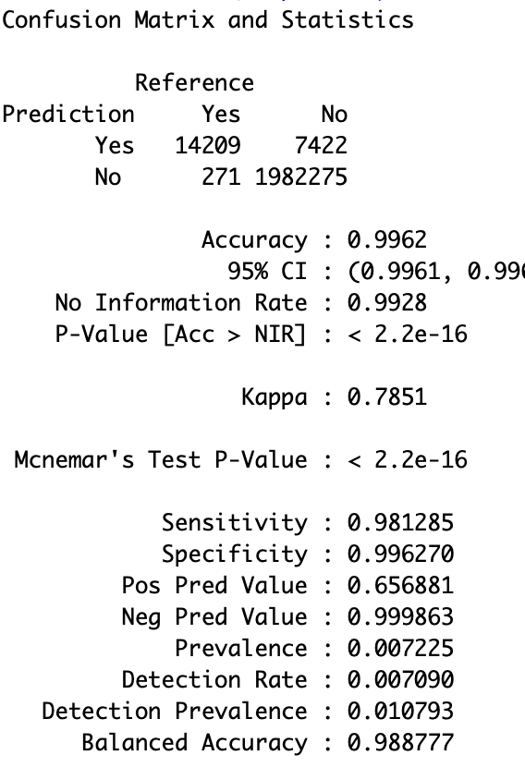
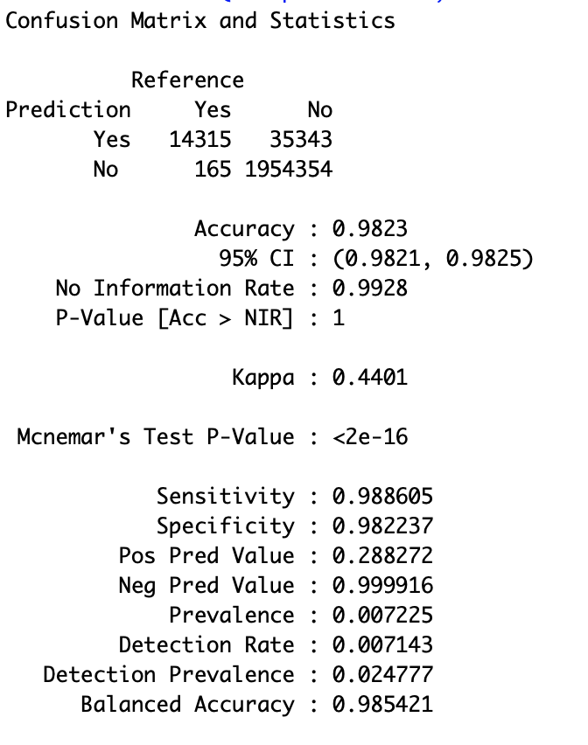
Conclusions
Confusion Matrices for Logistic and SVM are below. Logistic is on the left.

Slide 12
Conclusions
As you can see on the confusion matrices, SVM had a slightly better detection rate but Logistic regression had a much better false alarm rate. It seems that a trade-off for slightly fewer blue tarps found in exchange to many fewer “false alarms” that could waste rescuers’ time is good.
Sensitivity was a better metric for model selection with this data, versus accuracy or ROC, which are often the default in caret and other packages. The AUCs of the various models are misleading for our purposes in terms of which models are the most useful (because all models had a fairly low false alarm rate).
Logistic regression is significantly faster than SVM, also making it a better choice.
Our final choice for best model is logistic regression with a cut-off probability of 0.6. Using a lower probability threshold resulted in many more false alarms vs a modest increase in detection rate.

